Slide 1

School of Computing Science and Engineering
Course Code : BCS01T1001 Course Name: Data Analytics
UNIT IV
Getting Data, visualizing data on maps
Name of the Faculty: Bibhas Kumar Rana Program Name: B.Tech

Slide 2

Software process and Process Models
Getting Data, visualizing data on maps
Connect to Data:
To begin analyzing your data, first connect Tableau to one or more data sources.
A data source can be as simple as an Excel workbook, or as elaborate as a SQL Server or Oracle data warehouse.
After connecting, the data fields become available in the Data window on the left side of the workbook.
Program Name: B.Tech
‹#›

Slide 3
Software process and Process Models
Getting Data, visualizing data on maps
Supported Data Sources:
Tableau supports a wide variety of data sources, including Microsoft Office files, SQL databases, comma delimited text files, and multi-dimensional databases.
Program Name: B.Tech
‹#›

Slide 4
Software process and Process Models
Getting Data, visualizing data on maps
How to Connect to a Data Source:
To build views of your data, you must first connect Tableau to a data source.
You can connect to any supported data source with the Connect to Data dialog box.
Program Name: B.Tech
‹#›

Slide 5
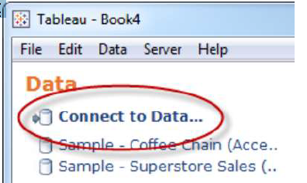
Software process and Process Models
Getting Data, visualizing data on maps
Cont…
1. Select Data > Connect to Data or press Ctrl + D on your
keyboard. You can also select the Connect to Data option on the start page.
Program Name: B.Tech
‹#›

Slide 6
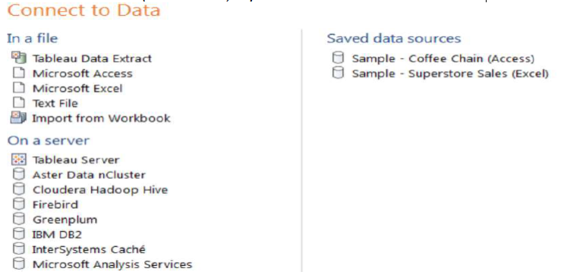
Software process and Process Models
Getting Data, visualizing data on maps
Cont…
2. On the Connect to Data page, select the type of data
you want to connect to. You can also select a saved data
connection (TDS files) open a Tableau Server Data.
Program Name: B.Tech
‹#›

Slide 7
Software process and Process Models
Getting Data, visualizing data on maps
Cont…
3. A data source-specific dialog box opens that allows you to complete the connection process.
Another way to connect to data is to import from a workbook. A workbook can contain multiple worksheets, each of which can be connected to a different data source.
To import a connection from a workbook click the Import from Workbook button at the bottom of the Select Saved Connection tab in the Connect to Data dialog box.
After the connection is established, the data source fields.
display on the left side of the workbook
Program Name: B.Tech
‹#›

Slide 8
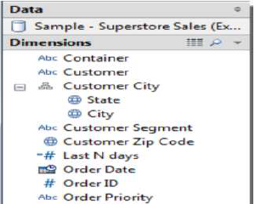
Software process and Process Models
Getting Data, visualizing data on maps
Cont…
Program Name: B.Tech
‹#›

Slide 9
Software process and Process Models
Getting Data, visualizing data on maps
Visualizing data:
A new connection to a data source is an invitation to explore and discover.
The visual analytics capabilities of Tableau empower you to rapidly and iteratively explore the data ask new questions, and make new discoveries.
Program Name: B.Tech
‹#›

Slide 10
Software process and Process Models
Getting Data, visualizing data on maps
Bar charts:
Bar charts visually represent data in a way that makes the comparing of values across different categories easy.
The length of the bar is the primary means by which you will visually understand the data.
You may also incorporate color, size, stacking, and order to communicate additional attributes and values.
Here the data considered as variation of the sample that ships with Tableau: Superstore, a fictional retail chain that sells various products to customers across the United States.
Program Name: B.Tech
‹#›

Slide 11
Software process and Process Models
Getting Data, visualizing data on maps
Bar charts:
1. Click on the the Sales by Department tab to view that sheet.
2. Drag and drop the Sales field from Measures in the data pane onto the Columns shelf. You now have a bar chart with a single bar representing the sum of sales for all the data in the data source.
3. Drag and drop the Department field from Dimensions in the data pane to the Rows shelf. This slices the data to give you three bars, each having a length that corresponds to the sum of sales for each department:
Program Name: B.Tech
‹#›

Slide 12
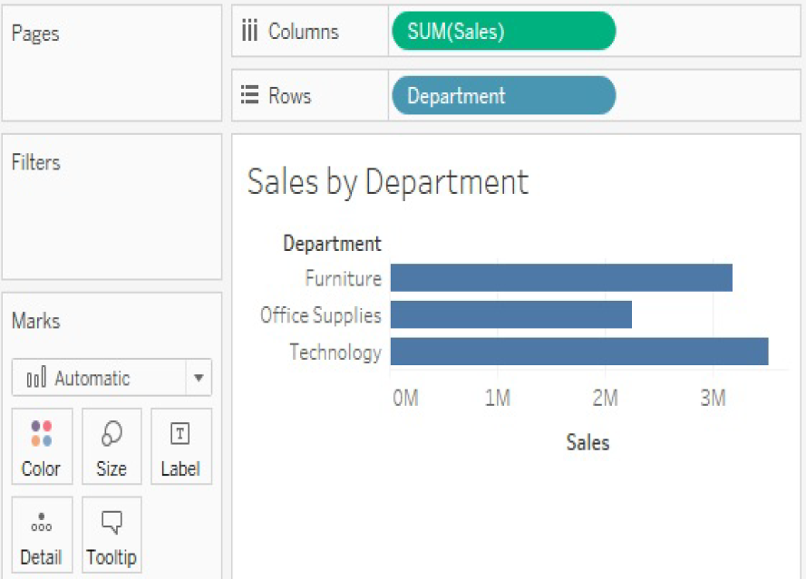
Software process and Process Models
Getting Data, visualizing data on maps
Bar charts:
You now have a horizontal bar chart. This makes comparing the sales between the departments easy.
Program Name: B.Tech
‹#›

Slide 13
Software process and Process Models
Getting Data, visualizing data on maps
Line charts:
Line charts connect related marks in a visualization to show movement or relationship between those connected marks.
The position of the marks and the lines that connect them are the primary means of communicating the data.
The most common kind of line chart is a Time Series.
A time series shows the movement of values over time. Creating one in Tableau requires only a date and a measure.
Program Name: B.Tech
‹#›

Slide 14
Software process and Process Models
Getting Data, visualizing data on maps
Steps:
1. Navigate to the Sales over time sheet.
2. Drag the Sales field from Measures to Rows. This gives you a
single, vertical bar representing the sum of all sales in the data
source.
3. To turn this into a time series, you must introduce a date. Drag the Order Date field from Dimensions in the data pane on the left and drop it into Columns. Tableau has a built-in date hierarchy, and the default level of Year has given you a line chart connecting four years. Notice that you can clearly see an increase in sales year
after year:
Program Name: B.Tech
‹#›

Slide 15
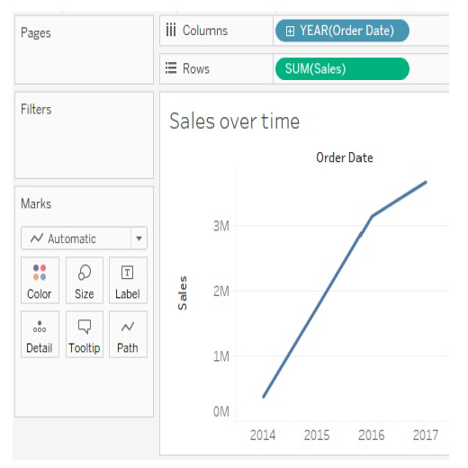
Software process and Process Models
Getting Data, visualizing data on maps
Program Name: B.Tech
‹#›

Slide 16
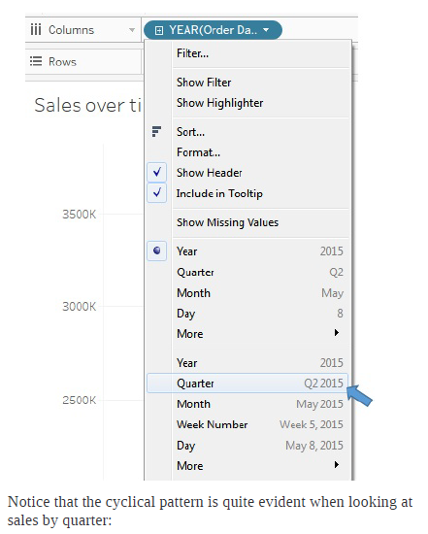
Software process and Process Models
Getting Data, visualizing data on maps
4. Use the drop-down menu on the YEAR(Order Date) field on Columns (or right-click the field) and switch the date field to use Quarter. You may notice that Quarter is listed twice in the drop-down menu.
Program Name: B.Tech
‹#›

Slide 17
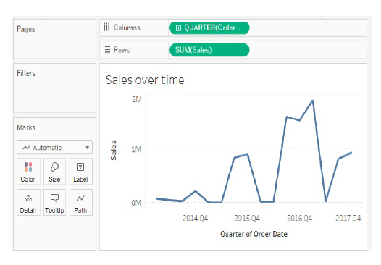
Software process and Process Models
Getting Data, visualizing data on maps
Program Name: B.Tech
‹#›

Slide 18
References
https://www.slideshare.net/girishsrivastava1/my-tableau/32
Learning Tableau 2019 Tools for Business Intelligence, data prep, and visual analytics by Joshua N. Milligan, 3rd Edition, 2019
Program Name: B.Tech

Slide 19
Contact Information
Program Name: B.Tech
‹#›

Slide 20


